Slide 1
Exploring the Treasures of the Indian Museum Kolkata
PRESENTED BY: MADHAVI GHOSH BATCH, 4 ITC GARDENIA,BANGALORE

Slide 2
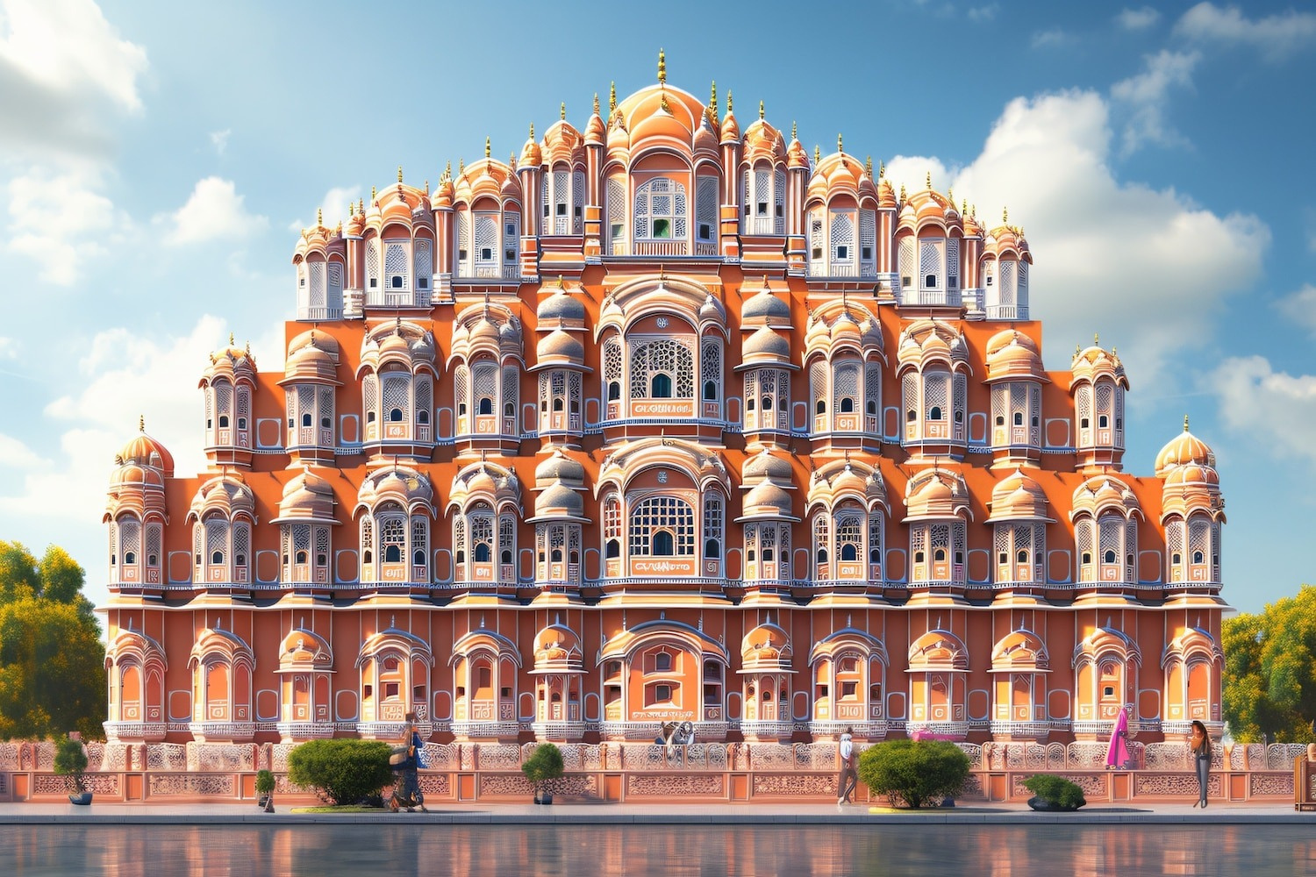

The Indian Museum Kolkata is the oldest and largest museum in India, with a
collection spanning artifacts from ancient civilizations to modern times. It is a
treasure trove of cultural heritage, showcasing exquisite sculptures, paintings, and textiles.

Slide 3
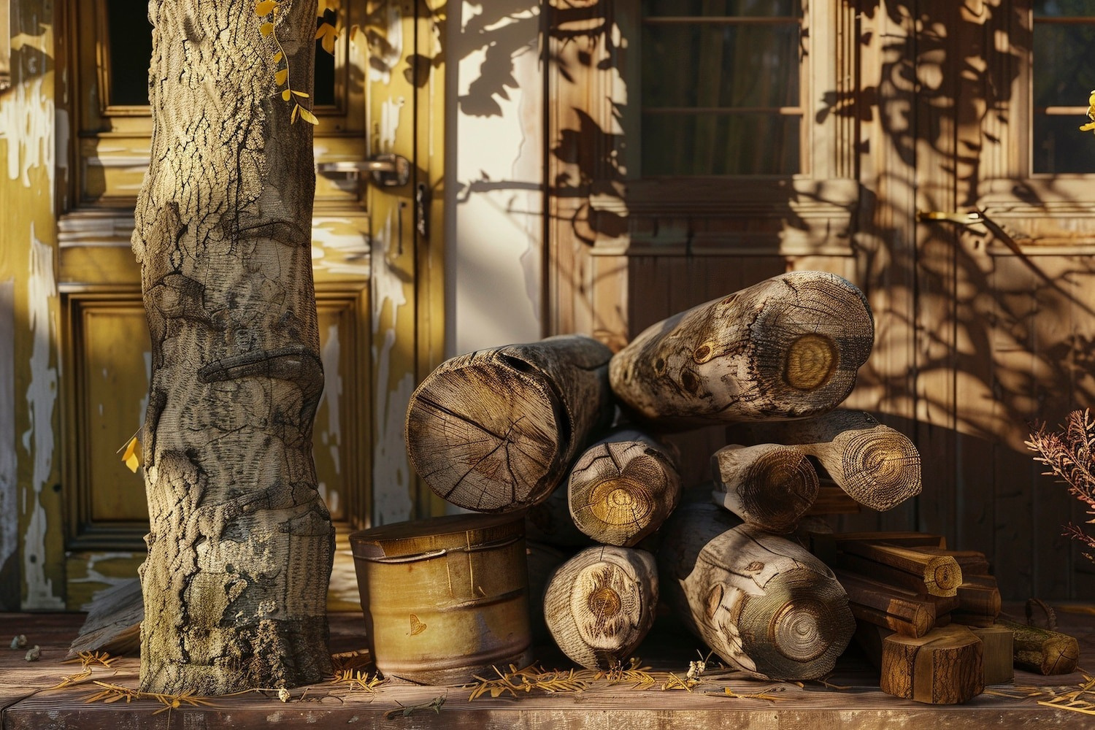
The museum houses a remarkable collection of ancient artifacts including coins, seals, and pottery from the Indus Valley Civilization. These artifacts provide a glimpse into the rich history and cultural traditions of ancient India.

Slide 4

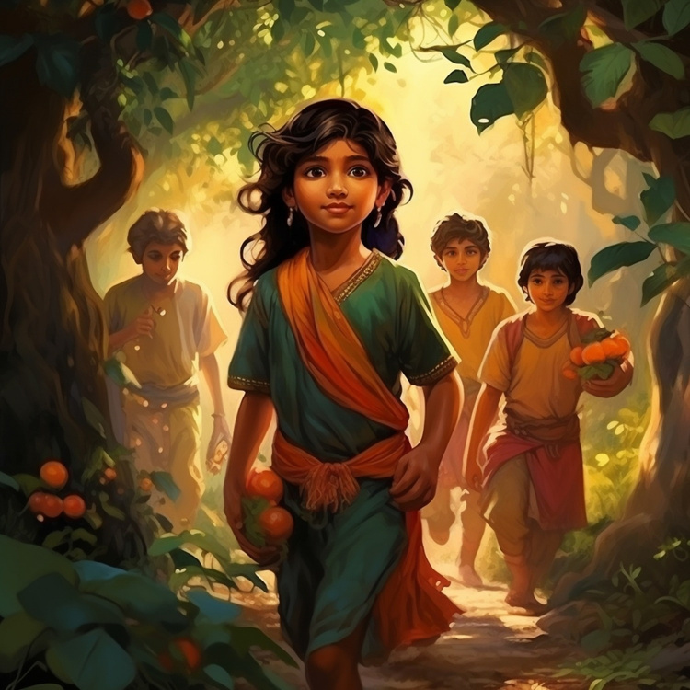
Bengal School Paintings
The museum is renowned for its collection of Bengal School paintings, a signiﬁcant art movement in India. These paintings,
characterized by their ethereal beauty and spiritual themes, offer a unique insight
into the artistic heritage of Bengal.

Slide 5
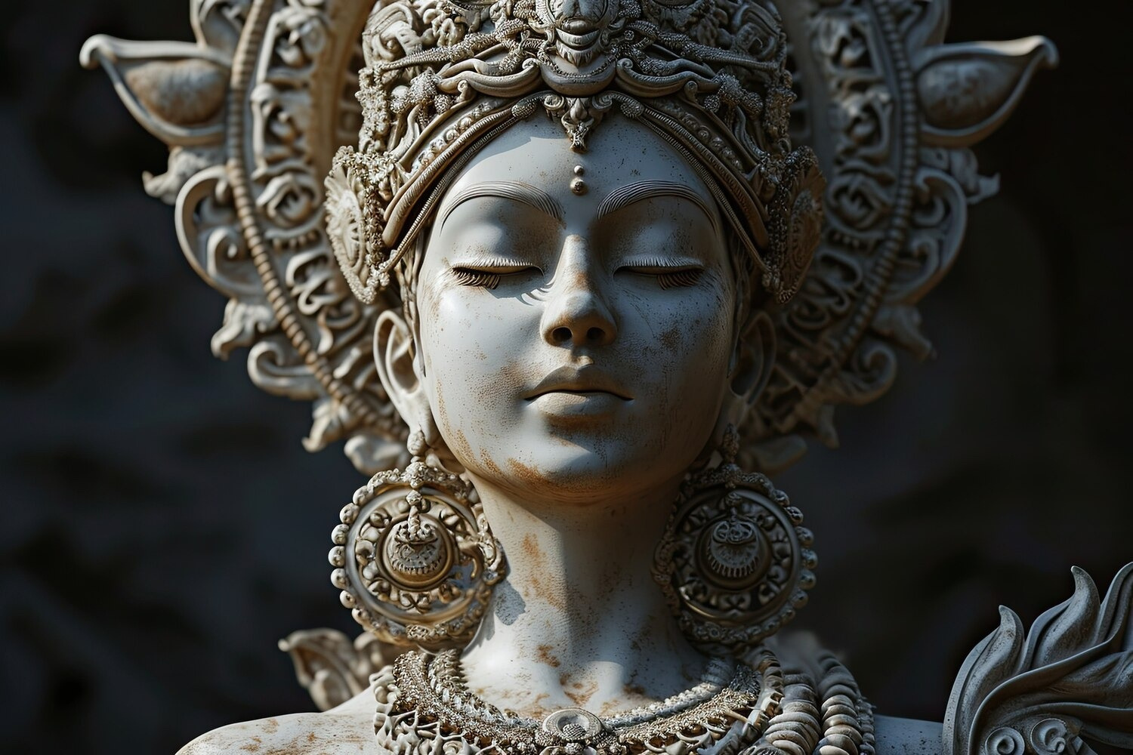
The sculpture gallery at the Indian Museum showcases an impressive array of ancient sculptures representing various periods and styles of Indian art. These sculptures depict deities, mythological ﬁgures, and everyday life, reﬂecting the diverse cultural tapestry of India.

Slide 6



Textile Treasures
The museum's collection of textiles
includes exquisite saris, shawls, and embroideries that highlight the rich textile
traditions of India. These intricate textiles showcase the craftsmanship and artistic excellence of Indian weavers and artisans.

Slide 7

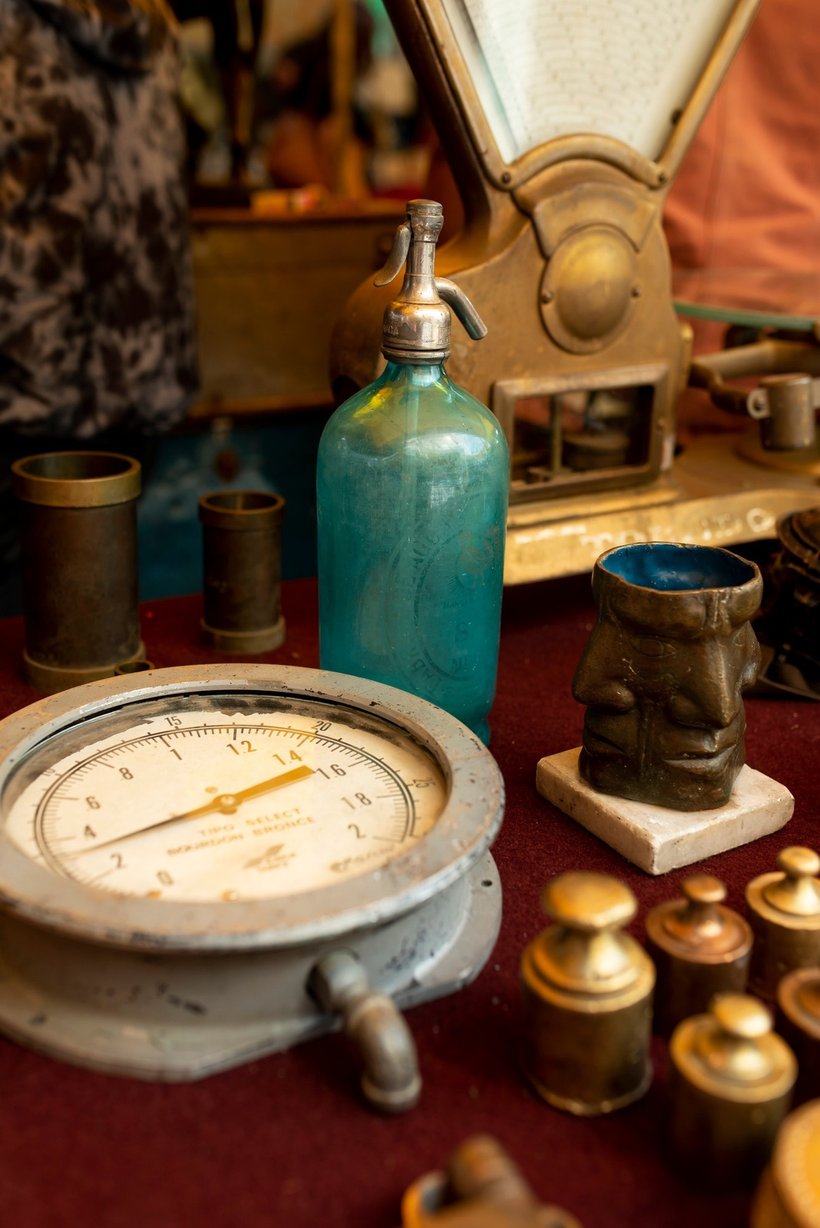
Conclusion
The Indian Museum Kolkata is a veritable treasure trove of India's cultural heritage, offering a captivating journey through the country's art, history, and traditions. It stands as a testament to the artistic and cultural legacy of India, preserving and presenting its treasures for generations to come.

Slide 8
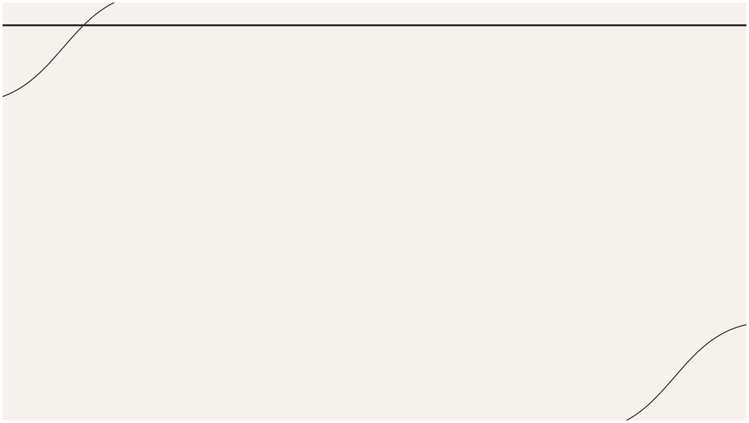
Thanks!

